Slide 1
Dept. of Communication Engineering College of Engineering- University of Diyala Lecture No.: 3 part(4)
3rd year Class
Antenna Theory and Design Lec. Jinan N. Shehab
Effective Area/ Effective Aperture/ Capture Area:-
Atransmitting antenna transmits EM waves and receiving antenna receiving a fraction of the same. It is a useful parameter for calculating the receive power of an antenna.An effective area over which it extracts EM energy from travelling EM waves. There are five types of antenna aperture:-
1- Antenna Effective Aperture (Area):-
Effective aperture parameter describes how much power power is captured from plane wave.
Or can be defined the ratio of power received at the antenna load terminal to the poynting vector or power density (W/m²) of incident wave:-
Effective area=
����𝒓𝒓���𝒊���
��𝒚�𝒕𝒊�� ���𝒕�𝒓�� 𝒊��𝒊���𝒕�𝒂��
�_{𝒓}
𝑨� = � ���_{𝒓}= � 𝑨�
S= poynting vector of incident plane wave, (W/m²).
This area effects in the losses intrinsic to the antenna (ohmic loss, dielectric loss etc.)
Let a receiving antenna be placed in the field of plane polarized travelling waves, having an (Ae) and the receiving antenna (dipole), terminated at a load impedance, ZT.
Where ZT= RT+j XT
E
Direction of propagation of plane polarised wave
͠͠
I
ZT
ZT
ZA
Received Antenna
Equivalent ciruit of the figure
2
If , I= terminal current , then recived power,= Prec = 𝐼�.�.���
Where RT= load resistance. Ir.m.s= terminal r.m.s current.
2
�
𝐴_{𝑒}=
��𝑒�^{𝐼}�.�.� �
=
� �

Slide 2
Dept. of Communication Engineering College of Engineering- University of Diyala Lecture No.: 3 part(4)
3rd year Class
Antenna Theory and Design Lec. Jinan N. Shehab
The antenna extracts energy from incident EM waves , delivers the same terminated ZT and power flowing per m² or poynting vector is P (W/m²). This entire cirucit can be replaced by an equivalent circuit as above figure, according Thevenin's theorem.
The voltage V is induced by passing EM waves it produces current Ir.m.s through terminal load impedance ZT.
𝐼= �
𝑉𝑉
+ � ⁼ (� + �𝑋) + (� + �𝑋)
� 𝐴
�
� 𝐴𝐴
|𝑉| |𝑉|
|𝐼| = =
√(�� + �_{𝐴})² + �(𝑋� + ��_{𝐴})² √(�� + �� + �� )² + �(𝑋� + ��_{𝐴})²
�_{�𝑒�}= 𝐼². �� =
𝑉²�_{𝐿}
(�� + �_{𝐴})² + (𝑋� + �_{𝐴})²
This is the power delivered by an antenna at the terminating ZT. Now by the defination of Ae
𝑉²�� 𝑉²��
^{𝐴𝑒=} [(� + � )² + (𝑋+ 𝑋)²]� ⁼ [(� + � + � )² + (𝑋+ 𝑋)²]�
� 𝐴� 𝐴� � � � 𝐴
This expression is for effective area or aperture or capture area in terms of power density (poynting vector), induced voltage V antenna impedance ZA and terminating load impedance ZT.
The V is maximum when the antenna is oriented for maximum response and the antenna and the incident wave both have the same polarization.
�_{𝐴}= �� + ��
According to maximum power transfer theorem, maximum power will be transferred from antenna to the antenna terminating load if and only if:-
𝑋� = −�_{𝐴}��� �� = �_{𝐴}= �� + ��
�� = �� �� �� = 0
��𝑒�⁼ _{(�}
𝑉²�� 𝑉²�_{𝐿}
𝑉²�_{𝐿}
�
+ � )² + (𝑋+ �𝑋)² ⁼ [(� + � + � )² + (𝑋+ 𝑋)²] ⁼ [(� + � )² + 0
𝐴�
𝐴
�
�
� � 𝐴�
�
𝑉²��
_{𝑉}2 _{𝑉}2
��𝑒𝑐�𝑎𝑥⁼ _{4�}2
= =
4� 4�
�
� �

Slide 3
Dept. of Communication Engineering College of Engineering- University of Diyala Lecture No.: 3 part(4)
3rd year Class
Antenna Theory and Design Lec. Jinan N. Shehab
Then, maximum effective aperture can be given as:-
��𝑒𝑐�𝑎𝑥
_{𝑉}2
�² �� 𝜆²
^{𝐴}𝑒�𝑎𝑥⁼
� ⁼ 4� . �
�
2- Scattering Aperture AS:-
The voltage induced in the antenna produces a current through both the ZA and the terminal ZR. The power produced in the antenna is divided into parts PLand PS. PL is the loss power , while PSis the Scattered power from the radiation resistanse. This aperture AS is defined as ratio of the re-radiated power to the power density of the incident wave.
2
�� 𝑉��
2
𝐴� = � �ℎ��� �� = 𝐼�� = _{[(�}
�
+ �� + �� )² + (𝑋� + 𝑋_{𝐴})²]
When Rl=0, RA=Rr and XT=-XA for maximum power transfer then:-
_{𝑉}2
𝐴� = _{4� �} = 𝐴_{𝑒}(������� ��������� ��������)
�
For the short circuit antenna (XT=-XA & RT=0) antenna resonant:-
_{𝑉}2
𝐴� = � � = 4𝐴_{𝑒}
�
3- Loss Aperture AL:-
The total power dissipated as heat by the receiving antenna is defined as the product of the incident power density and the antenna loss area (AL), if RL≠ 0.
𝑷_{𝑳}= � 𝑨_{𝑳}
2
𝑨_{𝑳}=
𝑰^{𝟐}�_{𝒍}
𝑉�_{𝐿}
�
=
[(� + � + � )² + (𝑋+ 𝑋)²] �
� � � � 𝐴
4- Collecting Aperture (Antenna Capture Area)AC:-
The total power captured by the receiving antenna (power delivered to the load + power scattered by the antenna + power dissipated in the form of heat) is defined as the product of the incident power density and the antenna capture area (Ac).
𝑷_{𝑪}= � 𝑨_{𝑪}
𝑉²(� + �� + ��)
𝑨_{𝑪}= 𝑨� + 𝑨_{𝑳}+ 𝑨� =
�
2 2
[(�� + �� + ��) + (𝑋� + 𝑋_{𝐴}) ] �
Physical ApertureAP:-

Slide 4
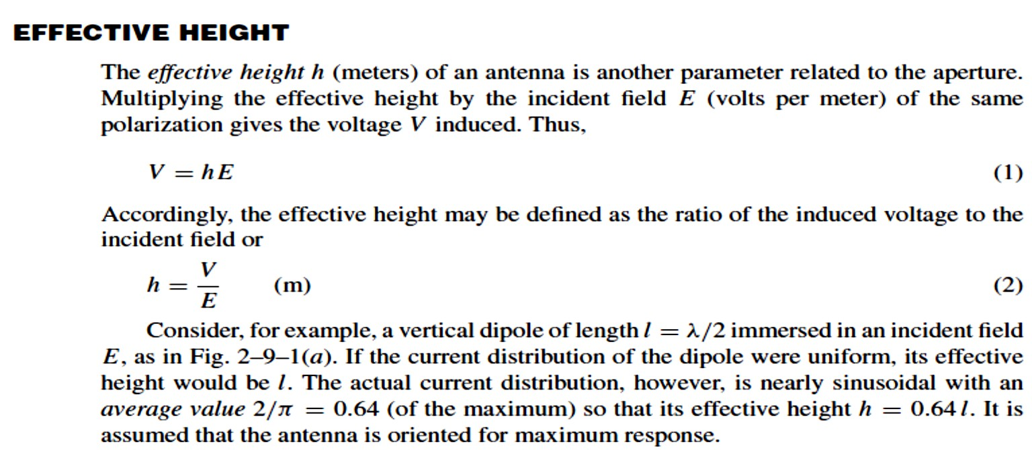
Dept. of Communication Engineering College of Engineering- University of Diyala Lecture No.: 3 part(4)
3rd year Class
Antenna Theory and Design Lec. Jinan N. Shehab
Is a measure of the physical size of the antenna.
𝜆² = 𝐴_{𝑒�} �_{𝐴}
𝐷= 4𝜋
^{𝐴}𝑒�
_{𝜆}2
Example:-
THE RADIO COMMUNICATION LINK:-

Slide 5
Dept. of Communication Engineering College of Engineering- University of Diyala Lecture No.: 3 part(4)
3rd year Class
Antenna Theory and Design Lec. Jinan N. Shehab
the formula gives the power received over a radio communication link. Assuming lossless, matched antennas, let the transmitter feed a power Pt to a transmitting antenna of effective aperture Aet . At a distance r a receiving antenna of effective aperture Aer intercepts some of the power radiated by the transmitting antenna and delivers it to the receiver R. Assuming for the moment that the transmitting antenna is isotropic, the power per unit area available at the receiving antenna is:-
^{�� =} 4𝜋�²
��
If the antenna has gain Gt , the power per unit area available at the receiving antenna will be increased in proportion as given by:-
�� 𝐺�
^{�� =} 4𝜋�²
Now the power collected by the lossless, matched receiving antenna of effective aperture
Aer is:-
�� =
�� ^{𝐺}�^{𝐴}𝑒�
4𝜋�²
The gain of the transmitting antenna can be expressed as:-
𝐺� =
4𝜋𝐴_{𝑒�}
_{𝜆}2
Substituting this Equ. in Equ. Above it yields the Friis transmission formula:-
�� =
�� 𝐺� 𝐺� 𝜆²
(4𝜋�)²
If the antenna are not polarization match, the above recived power could be multiplied by the polarization loss factor (PLF) to properly account for this mismatch.
where
Pr = received power, W
Pt = transmitted power, W
Aet
= effective aperture of transmitting antenna, m2
Aer = effective aperture of receiving antenna, m2
r = distance between antennas, m
λ = wavelength, m

Slide 6
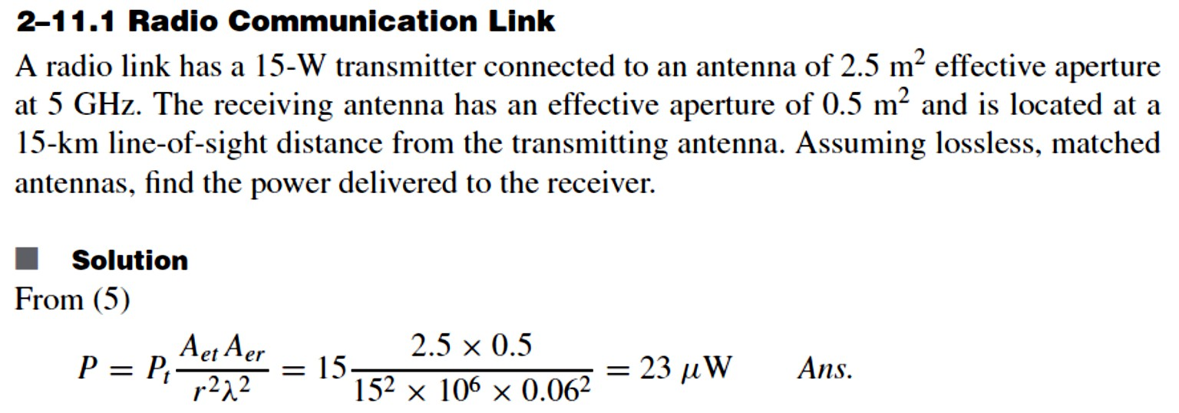
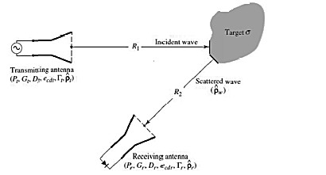
Dept. of Communication Engineering College of Engineering- University of Diyala Lecture No.: 3 part(4)
3rd year Class
Antenna Theory and Design Lec. Jinan N. Shehab
Radar equation:-
Assuming that the transmitted power is incident upon a target as shown in figure:-
�� 𝐺�
�𝑖�𝑐⁼ _{4𝜋�2}
The transmitted power incident upon the target is initially captured. Then, it is reradiated isotropically, insofar as the reciever concerned. The amount of captured power Pc is obtained by multiplying the incident power density by radar cross section:-
�_{𝑐}= 𝜎�_{𝑖�𝑐}
σ = radar cross section.
Radar cross section σ:- is the equivalent area of the target reradiated the incident power equally in all directions.
^{��𝑐𝑎� =} 4𝜋�² ⁼ 4𝜋�²
�_{𝑐}
^{𝜎�}𝑖�𝑐
�� ^{= 𝐴}𝑒� ��𝑐𝑎� ^{= 𝐴}𝑒� _{4𝜋�2} ⁼
^{𝜎�}𝑖�𝑐�� ^{𝐴}𝑒� ^{𝐴}𝑒� ^{𝜎}
�� 𝐺� 𝐺� 𝜎
4𝜋�²𝜆²
�� = _{(4𝜋)3�4} = ����� ��������

Slide 7
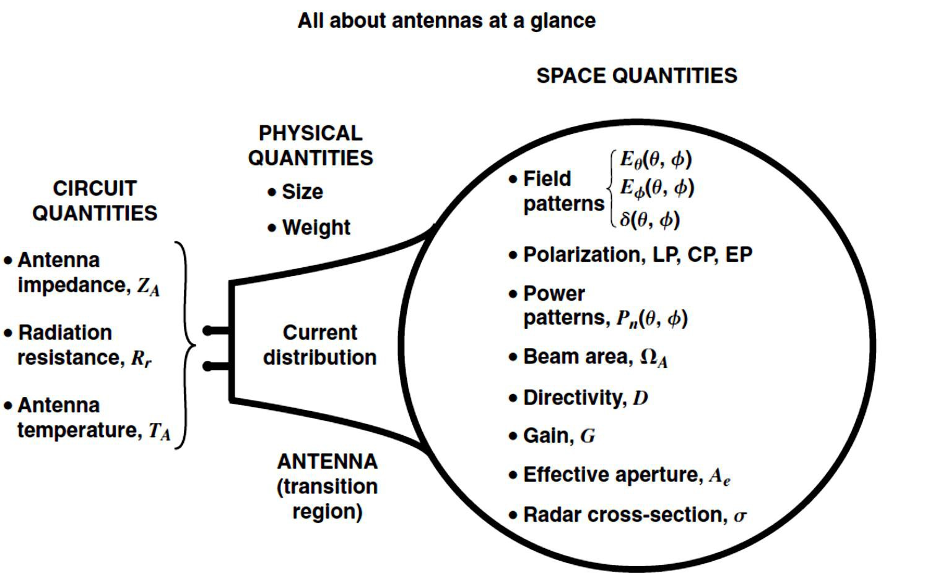
Dept. of Communication Engineering College of Engineering- University of Diyala Lecture No.: 3 part(4)
3rd year Class
Antenna Theory and Design Lec. Jinan N. Shehab
Amost the radar has only one G for transmitted and reciever then 𝐺� = 𝐺�
�� = _{(4𝜋)3�4} = ����� ��������
�� 𝐺²𝜎
This equation for clear whether if not we must take into account the loss factor, then:-
^{�� =} (4𝜋)³�⁴𝐿���
�� 𝐺²𝜎

